Slide 1
EES203: Geochemistry
Instructor: Anoop Ambili
Email id: anoop@iisermohali.ac.in

Slide 2
Isotope geochemistry

Slide 3
Stable Isotopes
Principles of stable isotope fractionation

Slide 4
Stable isotopes
Stable Isotope geochemistry is concerned with variations of the isotopic compositions of elements arising from physicochemical processes.
Many elements of low atomic weight have two or more stable isotopes, e.g.:
Hydrogen - H, D, T Carbon - ¹²C, ¹³C
Nitrogen - ¹⁴N, ¹⁵N Oxygen - ¹⁶O, ¹⁷O, ¹⁸O
Sulfur - ³²S, ³³S, ³⁴S, ³⁵S
The different masses cause isotopes to behave differently in physical and chemical processes.

Slide 5
What are isotopes?

Slide 6
History of Isotopy:
1914 Fredrick Soddy proposed that any place on periodic table can be occupied by more than one kind of atom
He proposed isotope ---- meaning “same place”
Isotopes ≡ Nuclides of single element having different atomic weights
Presently more than 2500 nuclides are known from ~110 elements

Slide 7
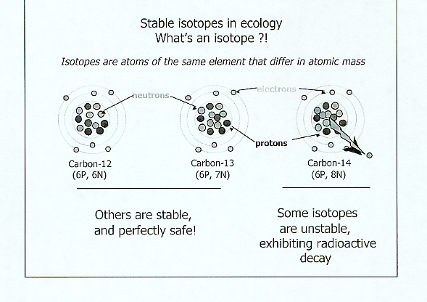
To be or not to be? - A stable isotope that is!

Slide 8
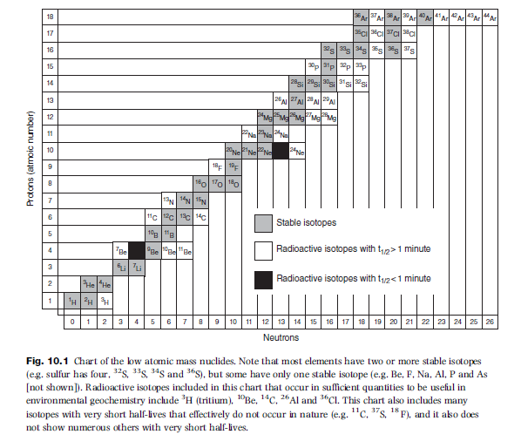

Slide 9
What isotopes are used in geological applications?

Slide 10
Average terrestrial abundances of the stable isotopes of elements used commonly (), occasionally (), and rarely () in geological studies
Element | Isotope | Abundance
Hydrogen | ¹H | 99.985
 | ²H | 0.015
Carbon | ¹²C | 98.89
 | ¹³C | 1.11
Nitrogen | ¹⁴N | 99.63
 | ¹⁵N | 0.37
Oxygen | ¹⁶O | 99.759
 | ¹⁷O | 0.037
 | ¹⁸O | 0.204
Magnesium | ²⁴Mg | 78.70
 | ²⁵Mg | 10.13
 | ²⁶Mg | 11.17
Silicon | ²⁸Si | 92.21
 | ²⁹Si | 4.70
 | ³⁰Si | 3.09
Element | Isotope | Abundance
Sulfur | ³²S | 95.00
 | ³³S | 0.76
 | ³⁴S | 4.22
 | ³⁶S | 0.014
Chlorine | ³⁵Cl | 75.53
 | ³⁷Cl | 24.47
Potassium | ³⁹K | 93.10
 | ⁴⁰K | 0.0118
 | ⁴¹K | 6.88
Calcium | ⁴⁰Ca | 96.97
 | ⁴²Ca | 0.64
 | ⁴³Ca | 0.145
 | ⁴⁴Ca | 2.06
 | ⁴⁶Ca | 0.0033
 | ⁴⁸Ca | 0.18
Element | Isotope | Abundance
Iron | ⁵⁴Fe | 5.82
 | ⁵⁶Fe | 91.66
 | ⁵⁷Fe | 2.19
 | ⁵⁸Fe | 0.33
Copper | ⁶³Cu | 69.09
 | ⁶⁵Cu | 30.91
Zinc | ⁶⁴Zn | 48.89
 | ⁶⁶Zn | 27.81
 | ⁶⁷Zn | 4.11
 | ⁶⁸Zn | 18.57
 | ⁷⁰Zn | 0.62
Strontium | ⁸⁴Sr | 0.56
 | ⁸⁶Sr | 9.86
 | ⁸⁷Sr | 7.02
 | ⁸⁸Sr | 82.56

Slide 11
Common isotopes
When we see this list of isotopes used in geological studies, note that it includes many of the most common isotopes in the solar system:
The 10 most common isotopes in the solar system are:
H >> ⁴He >> ¹⁶O > ¹²C >> ²⁰Ne > ¹⁴N > ²⁴Mg > ²⁸Si > ⁵⁶Fe > ³²S
The isotopes we study occur throughout the solar system and are important in lots of processes!

Slide 12
Expressing differences in stable isotope abundance

Slide 13
Absolute isotope abundances
are found at the third decimal
leading to small relative differences
Element | Isotope | Relative Abundance (% atoms)
Hydrogen (Deuterium) | ₁H¹ ₁H² (D) | 99.984 0.0156
Carbon | ₆C¹² ₆C¹³ | 98.892 1.108
Nitrogen | ₇N¹⁴ ₇N¹⁵ | 99.635 0.365
Oxygen | ₈O¹⁶ ₈O¹⁷ ₈O¹⁸ | 99.759 0.037 0.204
Are these relevant?
1.0860% ¹³C
1.0805% ¹³C

Slide 14
Stable isotope composition is expressed in δ (delta) notation:
δR in ‰ =
R_{sample}
–1 x 1000
R_{standard}

Slide 15
Stable isotope composition is expressed in δ (delta) notation:
δR in ‰ =
R_{sample}
–1 x 1000
R_{standard}
R is the isotope ratio of the HEAVY / LIGHT isotopes in either your sample or a standard
i.e. D/H, ¹³C/¹²C , ¹⁵N/¹⁴N , ¹⁸O/¹⁶O
and is a very small number

Slide 16
Stable isotope composition is expressed in δ (delta) notation:
δR in ‰ =
R_{sample}
–1 x 1000
R_{standard}
Delta notation indicates the isotope ratio in your sample relative to a standard.
If the isotope ratio in your sample equals the standard, R_{sample}/R_{standard} = 1 and δR = 0‰
The International Atomic Energy Association (IAEA) maintains a set of standards used for stable isotope measurements.

Slide 17
Stable isotope composition is expressed in δ (delta) notation:
δR in ‰ =
R_{sample}
–1 x 1000
R_{standard}
Because R_{sample} never deviates much
from R_{standard} (natural variation in isotope ratios is
limited), [(R_{sample} / R_{standard})-1] is a small number.
In order to make the variation more apparent, one multiplies the value by 1000, thereby expressing the value in per mil (parts per thousand ; ‰) notation

Slide 18
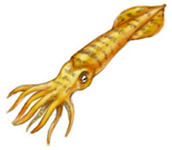
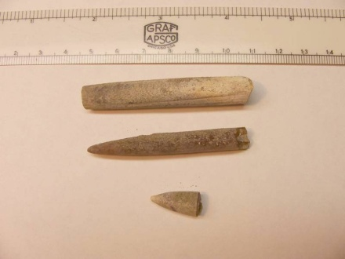

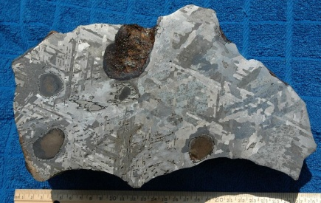
The δ (delta notation)
δ = [(R_{samp} – R_{std}) / R_{std}] x 1000
same as
Units are per mil “‰”
δ = [(R_{samp} / R_{std}) -1] x 1000
Again R is the ratio of the heavy to light isotope, and measured with a
mass spectrometer.
R_{std} is element specific
PeeDee Belemnite
SMOW
http://www.blackriverfossils.org/FlorenceCounty/tabid/53/TripReports/753/Default.aspx
FeS from Canyon Diablo Meteorite
http://www.sustainablesushi.net/tag/greenpeace/
http://meteorites.wustl.edu/id/metal.htm
Flying Belemnite: http://www.environment.gov.au/heritage/places/national/dinosaur-stampede/lark-quarry/environment-print.html

Slide 19
Standards
Some other international standards of known δ value:
Standard Light Antarctic Precipitation (SLAP) with values:
δD = -428‰ δ¹⁸O = -55.5‰
Greenland Icesheet Precipitation (GISP) with values:
δD = -189.7‰ δ¹⁸O = -24.8‰

Slide 20
delta notation
Those same two leaves have more interpretable isotope “values” in delta notation.
1.0860% ¹³C = δ¹³C -23‰
1.0805% ¹³C = δ¹³C -28‰

Slide 21
Using and referring to the delta values

Slide 22
LIGHT vs. HEAVY SAMPLES
a LIGHTER sample contains more of the lighter isotope, relative to another sample
a HEAVIER samples contains more of the heavier isotope, relative to another sample
DEPLETED vs. ENRICHED SAMPLES
a sample “DEPLETED” IN THE HEAVY ISOTOPE contains less of the heavy isotope and more of the light isotope, relative to another sample
a sample “ENRICHED” IN THE LIGHT ISOTOPE contains more of the light isotope and less of the heavy isotope, relative to another sample

Slide 23
Using the δD signature in H₂O as an example:
0
isotopically heavier
enriched in D (²H)
depleted in H
such values are found in warm climates, at low elevation and low latitudes, evaporated water
δD (‰)
-200
isotopically lighter
depleted in D (²H)
enriched in H
such values are found in cold climates, at high elevation and high latitudes
-400

Slide 24
Each isotopic measurement is reported relative to a standard
We define a measurement reporting convention (δ or “delta” units):
Note that ‘deltas’ are named
after the heavy isotope

Slide 25
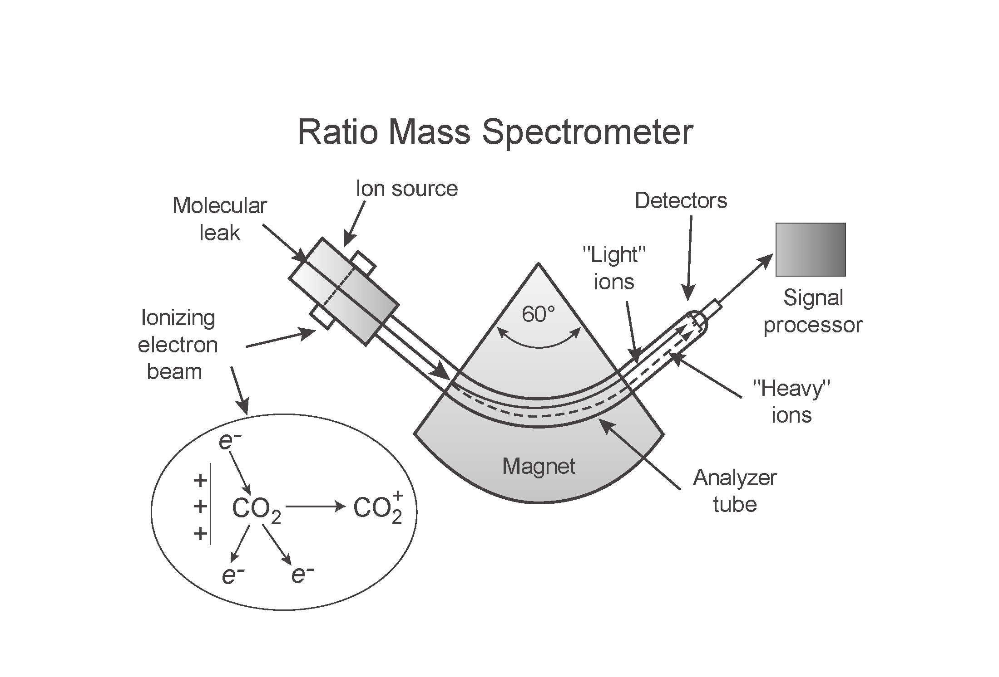
Isotope Ratio Mass Spectrometer (IRMS)
How we measure stable isotopes – the IRMS
1. Input as gases
2. Gases Ionized
3. Gases/ions accelerated in vacuum
4. Gases bent by magnetic field according to mass
5. Gases detected
1.
2.
5.
3.
4.
Isotopes are measured as ratios of two isotopes.
Standards are run frequently to correct for instrument stability

Slide 26
Some causes of variation in stable isotope values

Slide 27
Fractionation
Refers to the change in an isotope ratio that arises as a result of a chemical or physical process.
Occurs during:
- isotopic exchange reactions in which the isotopes are redistributed among different molecules containing that element (e.g., 1/2C¹⁶O₂ + H₂¹⁸O ↔ 1/2C¹⁸O₂ + H₂¹⁶O)
- unidirectional or incomplete reactions
- physical processes like evaporation/condensation, melting/crystallization, adsorption/desorption, diffusion

Slide 28
Isotopes
Chemical properties of any element are largely determined by the number and configuration of electrons (e-)
Since isotopes have the same number and configuration of electrons . . . . .
Isotopes have the same chemical properties
¹³CO₂ is chemically identical to ¹²CO₂

Slide 29
Isotopes
1. Isotopes have the same chemical properties
2. However, isotopes differ in then number of neutrons, N they possess, and therefore in mass
How do mass differences lead to variation is isotope abundance?
Mass differences influence chemical BEHAVIOR
in reactions or mixtures

Slide 30
Isotope mass effects
Differences in mass influence:
1. The RATES at which the isotopes react
Lighter isotopes react faster. Therefore different isotopes involved in a chemical reaction display differential representation in different phases of the reaction
2. The PHYSIO-CHEMICAL properties of molecules composed of different isotopes
That is, factors including vapor pressure, boiling temperature, freezing point, and melting point are affected by the isotope composition of a molecule.

Slide 31
Fractionation
Both the differences in physiochemical properties and reaction rates lead to the redistribution of isotopes
This process is known as fractionation
Fractionation can be caused by either bi-directional or unidirectional reactions

Slide 32
Isotope Fractionation Processes
Exchange/equilibrium [BI-directional]
Complete back-reaction
Product/reactant offset by constant fractionation factor
Kinetic [UNI-directional] = “biological”
Incomplete back-reaction (extreme case-Rayleigh distillation)
Product and reactant d can evolve in concert (closed system), or product composition determines reactant composition (open system)
Transport/Diffusion [UNI-directional]
Subset of kinetic fractionation reactions involving flux along a concentration gradient

Slide 33
Isotope Fractionation Processes
Equilibrium Isotope effects
Occurs in equilibrium reactions (reactions can go both ways) if the system is in equilibrium
Chemical equilibrium
Phase changes (closed system)
Heavier isotope equilibrates into the compound or phase in which it is most stably bound
Within a molecule (CO₂ vs HCO₃⁻)
Between molecules (CO_{2(g)} vs CO_{2(aq)} )
Differences in vibrational energy is the source of the fractionation.
Heavier isotopes wind up in the compound where it is bound more strongly

Slide 34
Equilibrium Isotope effects
Isotope effect associated with zero-point energy
DISSOCIATED ATOMS
{Morse Potential Curve}
Differences in ZPEs are the fundamental cause of equilibrium isotope fractionation
Potential energy
H-H
ZERO POINT ENERGY LEVELS (ZPEs)
D-D
ABSOLUTE ZERO
Interatomic distance

Slide 35
Physio-chemical differences
Isotope effect associated with zero-point energy
DISSOCIATED ATOMS
THESE VALUES ARE THE AMOUNT OF ENERGY REQUIRED TO BREAK THE BOND; MORE ENERGY IS NEEDED TO BREAK THE D-D BOND THAN THE H-H BOND, LEADING TO ISOTOPE EFFECTS
Potential energy
E_{L} = 103.2
E_{H} = 105.3
H-H
D-D
Interatomic distance

Slide 36
Reaction rate differences
✴ Differences in mass also influence the RATES at which the isotopes react
✴ The lighter isotope reacts at a faster rate, leading to a heavier d value in the remaining substrate relative to the product.
-- Therefore, differences in MASS influence RATES and lead to ISOTOPE FRACTIONATION

Slide 37
Equilibrium Isotope effects
The heavy isotope forms a lower energy bond; it does not vibrate as violently. Therefore, it forms a stronger bond in the compound.
The Rule of Bigeleisen (1965) - The heavy isotope goes preferentially into the compound with the strongest bonds.

Slide 38
Fractionation
Uni-directional reactions
Known as KINETIC FRACTIONATION
Differences in physio-chemical properties and reaction rates never result in uni-directional exchange of isotopes (there is no back-reaction)
Referred to as DISCRIMINATION if it is biologically (enzyme mediated) fractionation

Slide 39
2. Kinetic Fractionation
Occurs in
unidirectional (irreversible) reactions
reversible reactions that are not yet at equilibrium
diffusion or differential bond breaking
Heavier isotopes move more slowly (KE = ½ mv²)
Therefore react more slowly
Reaction products are depleted in the heavy isotope relative to the reactants
All isotopes effects involving organic matter are kinetic

Slide 40
2. Kinetic Fractionation
Consider two molecules of CO₂: ¹²C¹⁶O₂ (mass = 12 + 2*16 = 44)
and ¹³C¹⁶O₂ (mass = 13 + 2*16 = 45)
if their energies are the same, then:
and the ratio of their velocities is:
assuming
ideal gas
SO… ¹²C¹⁶O₂ can diffuse 1.1% further than ¹³C¹⁶O₂ in a given amount of time
This can be observed as gas moves through a fine capillary tube (¹²C¹⁶O₂ arrives first).

Slide 41
Examples of Kinetic Fractionation
1. Unidirectional reactions
Example:
Carbon fixation via photosynthesis:
¹²CO₂ + H₂O -> ¹²CH₂O + O₂ Faster
¹³CO₂ + H₂O -> ¹³CH₂O + O₂ slower
Organic matter gets depleted in ¹³C during photosynthesis (decreases in δ¹³C)
2. Reversible reactions that are not yet at equilibrium
Example:
Evaporation of water vapor if not in equilibrium (net evaporation ie: N .Atlantic)
H₂¹⁶O_{(l)} -> H₂¹⁶O_{(g)} faster
H₂¹⁸O_{(l)} -> H₂¹⁸O_{(g)} slower
Water vapor gets depleted in 18O during net evaporation (decreases in δ¹⁸O)
3. Diffusion
Example:
Diffusion of H₂Oacross a cell membrane
H₂¹⁶O_{(l)} outside cell -> H₂¹⁶O_{(l)} inside cell faster
H₂¹⁸O_{(l)} outside cell -> H₂¹⁸O_{(l)} inside cell slower
Water vapor gets depleted in 18O during net evaporation (decreases in δ¹⁸O)

Slide 42
Equilibrium Fractionation vs Kinetic Fractionation
The difference depends on the reason for the fractionation
Equilibrium fractionation occurs so that the total energy of the system is minimized via forming the most stable bonds possible
Equilibrium is related to bond stability of the isotope
Kinetic fractionation occurs because smaller molecules move faster than heavier molecules and therefore react more slowly
Kinetic is related to the velocity of the isotope

